Slide 1
CREDIT EDA Case - Study
Prepared by:
Shivam Kumar Jaiswal

Slide 2
* Purpose of Case - Study * Data Cleaning and Data Manipulation * Univariate Analysis * Bivariate Analysis * Merger Univariate Analysis
Contents:

Slide 3
The objective of this case study is to analyze patterns in the loan application data to identify clients who may have difficulty paying their instalments. This analysis will help in making informed decisions such as denying the loan, reducing the loan amount, or offering a higher interest rate to risky applicants. By identifying such applicants through exploratory data analysis (EDA), the loan providers can ensure that applications from clients who can repay their loans are not rejected.
Purpose of Case - Study:

Slide 4
•First, we imported python libraries which are NumPy, pandas, seaborn and matplotlib. •After this, we read the given csv into 2 different data frame ‘inp0’ and ‘inp1’ using the pandas “pd.read_csv” function. •Then we found the percentage of null values present in each column of the data. •We dropped the columns with null value percentage more than 45% and the columns which were irrelevant for our analysis. • For columns with missing values that are less than 45 to 50%, the following strategies were used: 1. For numerical columns with no significant outliers, missing values can be imputed with the mean or median of the column. If the data is normally distributed, the mean can be used, while the median can be used for skewed data. 2. For numerical columns with significant outliers, the median should be used for imputing missing values as it is more robust to outliers than the mean. 3. For categorical columns, missing values can be imputed with the mode (most frequent value) of the column.
Steps of Data Cleaning and Data Manipulation:

Slide 5
• We corrected the values in the columns "DAYS_BIRTH", "DAYS_REGISTRATION", and "DAYS_ID_PUBLISH" by converting their negative values to positive values. These columns represent the number of days before the loan application when the client was born, registered, and their ID was published respectively. •To facilitate a better analysis, we converted the values in the columns "AMT_INCOME_TOTAL", "AMT_CREDIT", and "AMT_GOODS_PRICE" from their original units to units of lakhs. This conversion helps to simplify the values and makes it easier to identify patterns and trends in the data. • Additionally, we performed binning on two columns: "AMT_INCOME_TOTAL" and "DAYS_BIRTH". Binning involves grouping values into intervals or ranges and is a common technique used in data analysis to simplify the data and identify patterns. By binning the "AMT_INCOME_TOTAL" column, we can analyze the distribution of income levels and identify any patterns or trends that may exist within specific income ranges. Similarly, by binning the "DAYS_BIRTH" column, we can group clients into age ranges and analyze how age is related to loan repayment. •Then we checked the imbalance application data frame using target variable.

Slide 6
• Two new data frames were created based on the target value. One data frame (target_0) contained all the rows where the target value was 0, indicating that the loan was not defaulted. The other data frame (target_1) contained all the rows where the target value was 1, indicating that the loan was defaulted. • After creating separate data frames for the two target values (target_0 and target_1), we performed univariate analysis on several columns including "salary range", "age_group", "FLAG_OWN_CAR", "FLAG_OWN_REALTY", "CNT_CHILDREN", and "NAME_HOUSE_TYPE". • Following this, I conducted bivariate analysis to explore the relationships between the target variable and several other variables of interest. Specifically, examined the associations between the target variable and the following columns: "age_group", "AMT_INCOME_TOTAL", "AMT_GOODS_PRICE", "CODE_GENDER", "NAME_HOUSING_TYPE", and "FLAG_OWN_CAR". This analysis helped to identify patterns and relationships that may be indicative of a client's ability to repay loans. •We found correlation for data frames inp0, target_0 and target_1. •After this, we merged the data frame inp0 and inp1 using pd.merge() function. These two data frame was merged into a new data frame which we named merged. •Again, data cleaning was applied to this new data frame and then univariate and bivariate analysis was done on this data frame.

Slide 7
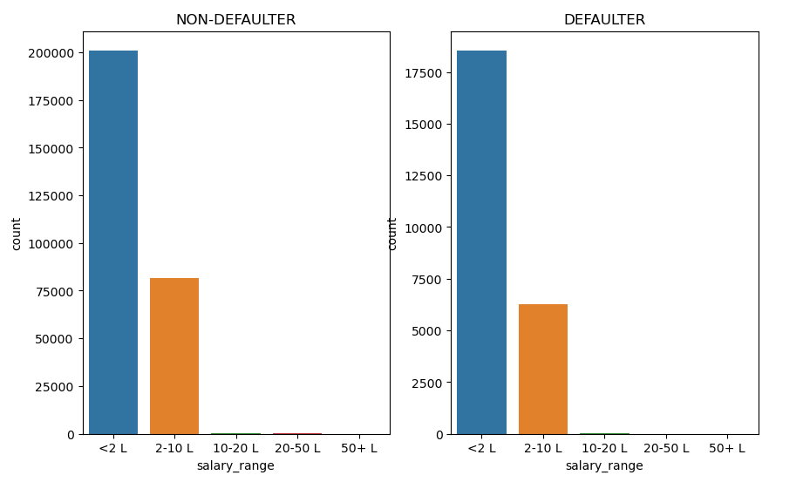
1. Sub-plot of count-plot type for variable "salary_range" form data frame target_0 and target_1 Findings: Based on the given plot, we can observe that many clients who have defaulted on their loans fall in the salary range of less than 2 lakhs. Conversely, there are very few clients who have defaulted in the salary range of above 10 lakhs. This suggests that clients with lower salaries are more likely to default on their loans compared to those with higher salaries.
Univariate Analysis Graphs:

Slide 8
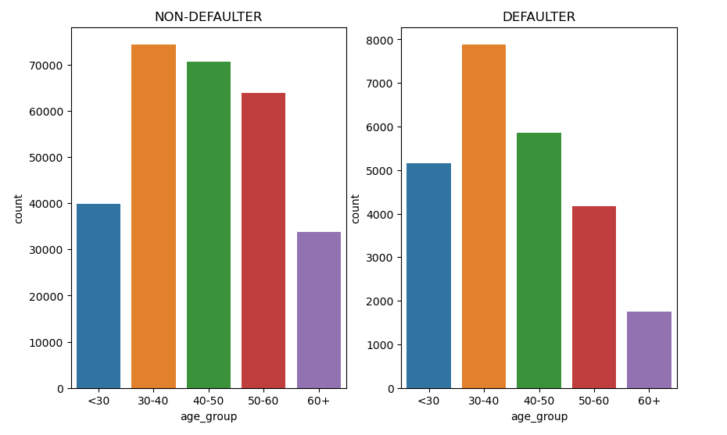
2. Sub-plot of count-plot type for variable "age_group" form data frame target_0 and target_1. Findings : Based on the given plot, we can observe that there is a relatively higher number of clients who have defaulted on their loans in the age group of 30 to 40. On the other hand, there are very few clients who have defaulted in the age group of above 60. This indicates that clients who are in the age range of 30 to 40 are more likely to default on their loans compared to those who are above 60 years old.
Univariate Analysis Graphs:

Slide 9
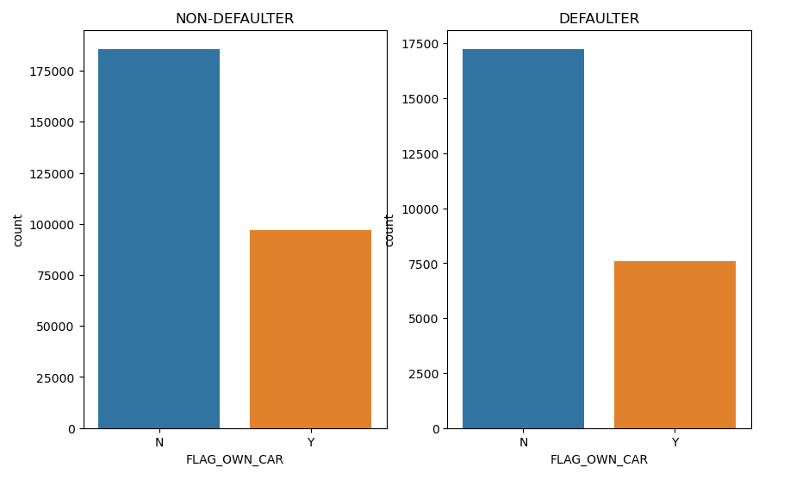
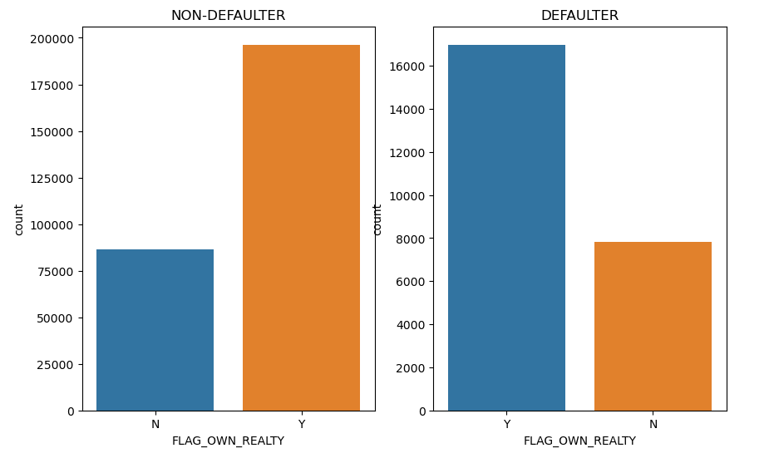
3. Sub-plot of count-plot type for variable "FLAG_OWN_CAR" form data frame target_0 and target_1. 4. Sub-plot of count-plot type for variable "FLAG_OWN_REALTY" form data frame target_0 and target_1. Findings: Based on the given plot, it is evident that a significant number of clients who have defaulted on their loans do not own a car. This suggests that clients who do not own a car are more likely to default on their loans compared to those who do own a car. Also, we can say that there are high number of DEFAULTER clients who owns a house.
Univariate Analysis Graphs:

Slide 10
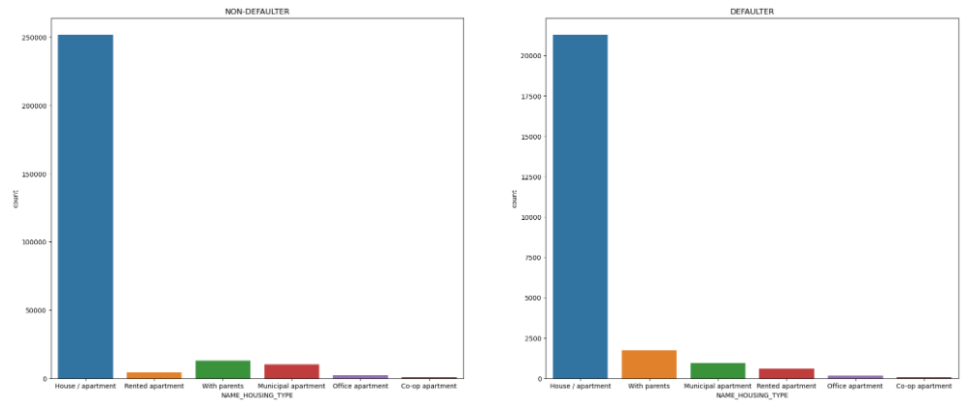
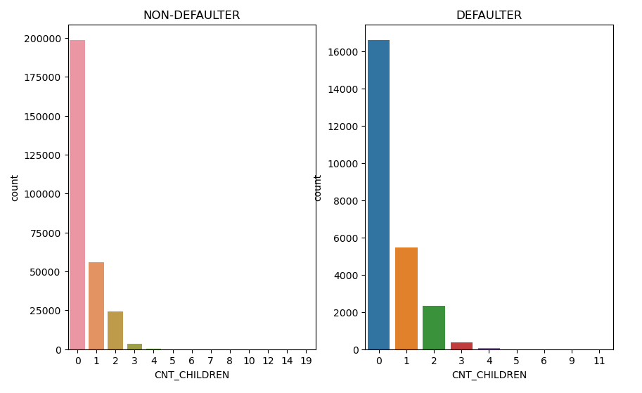
5. sub-plot of count-plot type for variable "CNT_CHILDREN" and “NAME_HOUSING_TYPE” form data frame target_0 and target_1. Findings: Based on the given plot, we can conclude that a considerable number of clients who have defaulted on their loans do not have any children. This suggests that clients without children are more likely to default on their loans compared to those who have children. Also, we can infer that a substantial number of clients who have defaulted on their loans live in their own house or apartment. This suggests that clients who own their own house or apartment are more likely to default on their loans compared to those who live in rented accommodations.
Univariate Analysis Graphs:

Slide 11
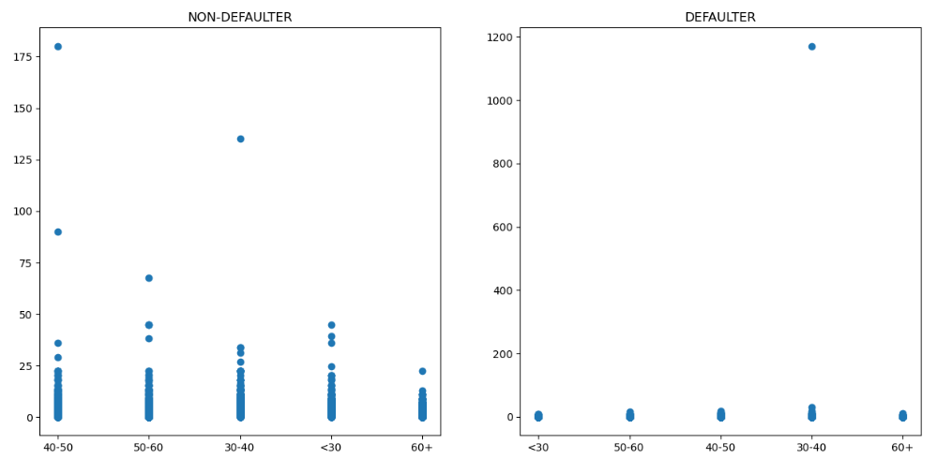
1. Analysis on 'age_group' column and 'AMT_INCOME_TOTAL' column using data frame target_0 and target_1. Findings: Based on the given plot, we can observe that clients who have defaulted on their loans in the age group of 30-40 generally have higher incomes compared to clients in other age groups. On the other hand, clients who have defaulted in the age group less than 30 have lower incomes compared to the other age groups. Given this information, it is less likely that clients in the age group less than 30 would be able to pay off their debt.
Bivariate Analysis Graphs:

Slide 12
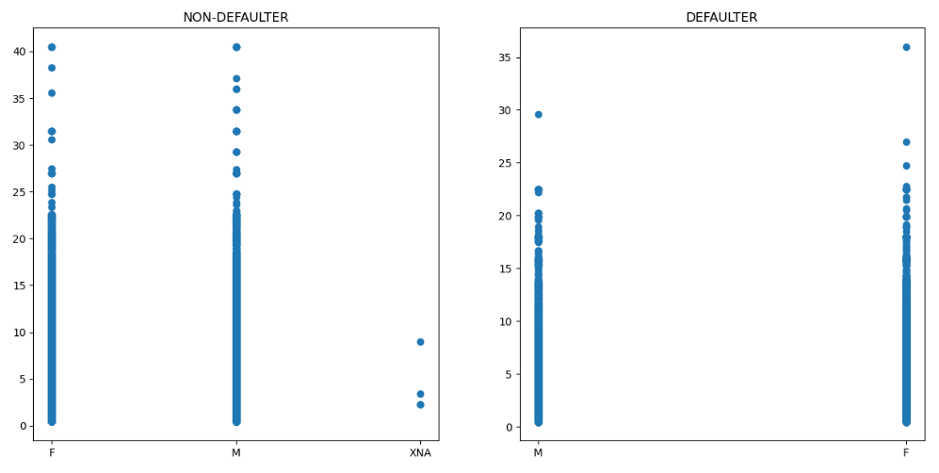
2. Analysis on ‘CODE_GENDER’ column and ‘AMT_GOODS_PRICE’ column using data frame target_0 and target_1. Findings: Based on the given plot, we can observe that male clients who have defaulted on their loans generally have a lower AMT_GOODS_PRICE value, with the majority falling below 22.5 lakhs. Conversely, female clients who have defaulted on their loans generally have a slightly higher AMT_GOODS_PRICE value, with the majority falling below 25 lakhs.
Bivariate Analysis Graphs:

Slide 13
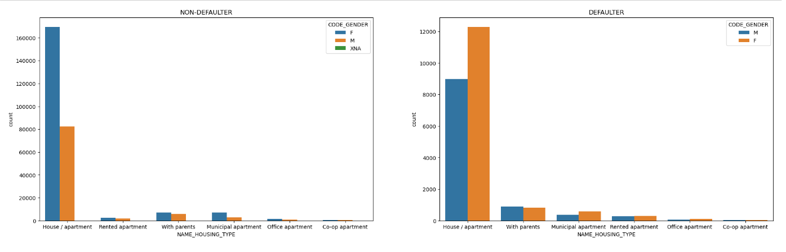
3. Analysis on 'NAME_HOUSING_TYPE' column and 'CODE_GENDER' column using data frame target_0 and target_1. Findings: Based on the given plot, we can observe that females who owns a house or apartment are more likely to be a defaulter, but the other factors seems to be normal for both the genders.
Bivariate Analysis Graphs:

Slide 14
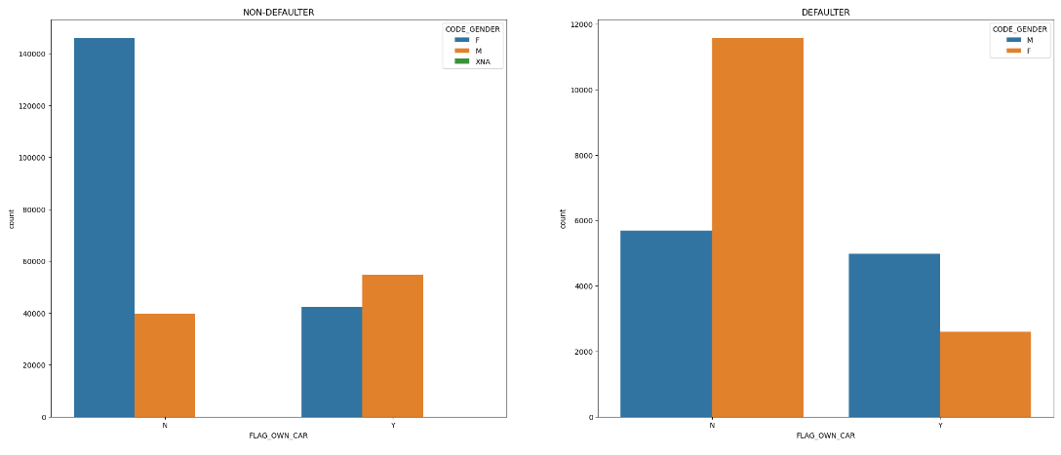
4. Analysis on 'FLAG_OWN_CAR' column and 'CODE_GENDER' column using data frame target_0 and target_1. Findings: Based on the given plot, we can observe that females who owns a car are more likely to be a defaulter.
Bivariate Analysis Graphs:

Slide 15
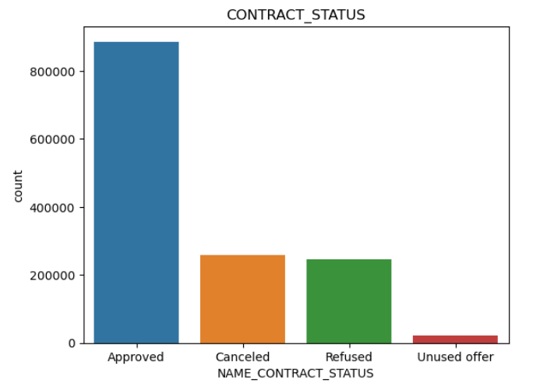
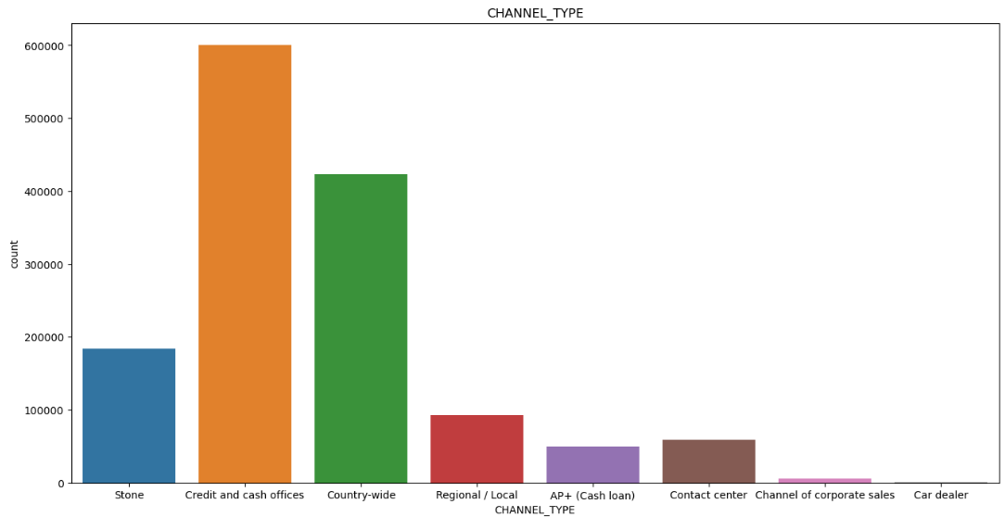
Based on the given plot, we can observe that most loan applications are approved, as indicated by the large portion of the pie chart labeled "Approved". Conversely, a small number of loan applications are either canceled or refused, as indicated by the smaller portions of the pie chart labeled "Canceled" and "Refused", respectively. Additionally, the portion of the pie chart labeled "Unused Offer" is also relatively small, indicating that few loan offers were unused by clients
Merged Univariate Analysis Graphs:

Slide 16
1. One effective way for a company to attract more clients is by investing in the infrastructure of its credit and cash offices. These offices are proven to be highly efficient in acquiring new clients and increasing overall business revenue. By enhancing the facilities and equipment of these offices, the company can create a welcoming and professional environment that fosters trust and confidence in potential clients. This can lead to an increase in customer loyalty and positive word-of-mouth recommendations. Overall, prioritizing the infrastructure of credit and cash offices can have a significant impact on the success of a business 2. There are more chances of women who owns a car and owns a house or apartment to be a defaulter of loan. 3. It is less likely that clients in the age group less than 30 would be able to pay off their debt. 4. The clients whose salary range is less than 2 lakhs are more likely to be a defaulter. 5. Clients from housing type ‘With parents’ are having least number of unsuccessful payments.
Recommendations:

Slide 17
Thank You !

